Slide 1

Dogs!
(Or Finding a New Best Friend)
Presented by: Angie Oehler

Slide 2
Questions to Answer
Why was this topic chosen?
How was the behavioral data collected by Dr. Coren?
What is the distribution of dog classifications?
Is there a relationship between dog size and lowest reps for new commands?
Why spend more time exploring dog height rather than dog weight?
What is the relationship between number of reps and how well the dog obeyed?
What method of analysis was least useful?
What method of analysis proved most useful/meaningful?
What was the most challenging aspect of working with this data
What is the benefit of this analysis?

Slide 3
Research Problem
Match a person with the best new dog to the new owner
Family with small kids
Active single person
Senior looking for companionship
Every group has different needs and abilities to care for and/or train a dog
Finding the right dog helps manage expectations
Foster better relationship with new pet

Slide 4
The Data
American Kennel Club
The breed name
The lower and upper breed height
The upper and lower breed weight
Dr. Coren’s Data
The breed name
The AKC size and classification
The likelihood the breed will obey initial commands
Lower & upper repetition limits for each bread

Slide 5
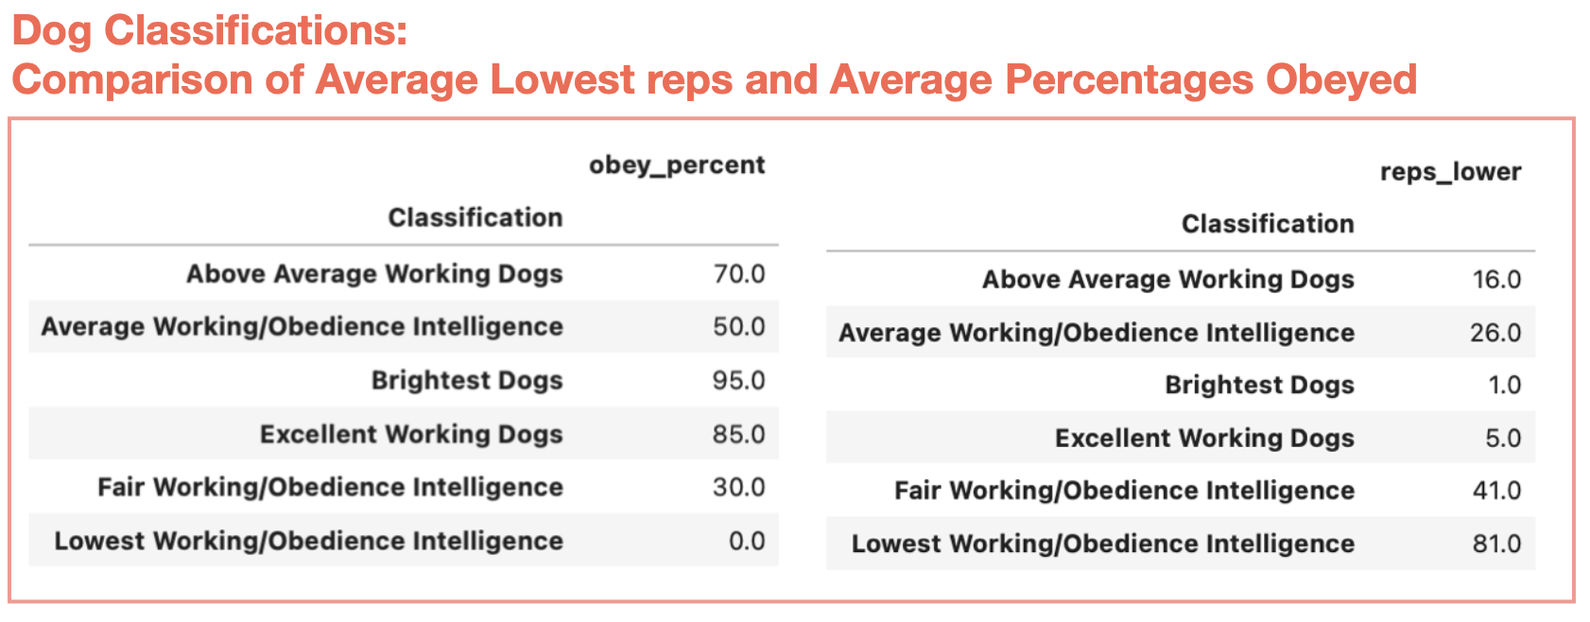
Average Working/Obedience - 38
Above Average Working Dogs - 27
Fair Working/Obedience - 20
Excellent Working Dogs - 19
Lowest Working/Obedience - 10
Brightest Dogs - 10

Slide 6
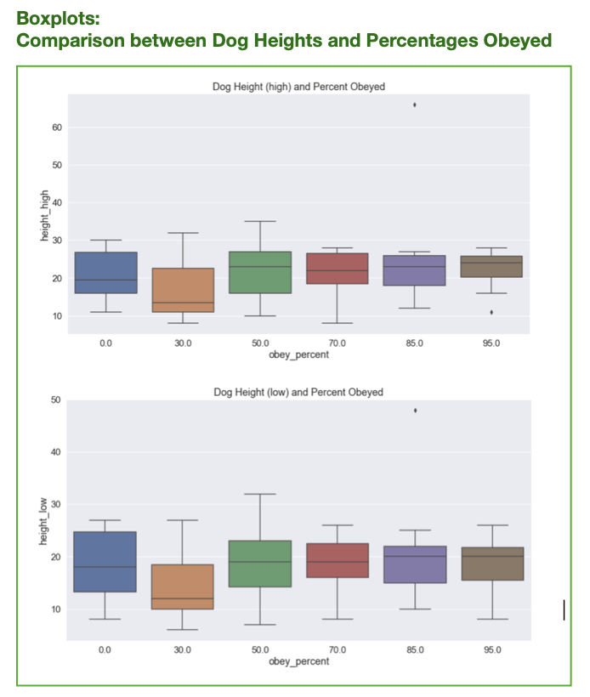
Analysis
General exploration of the data, which included:
counts:
min/max/mean
percentile
standard deviation for each column
General distributions
Variable comparisons
Plots

Slide 7
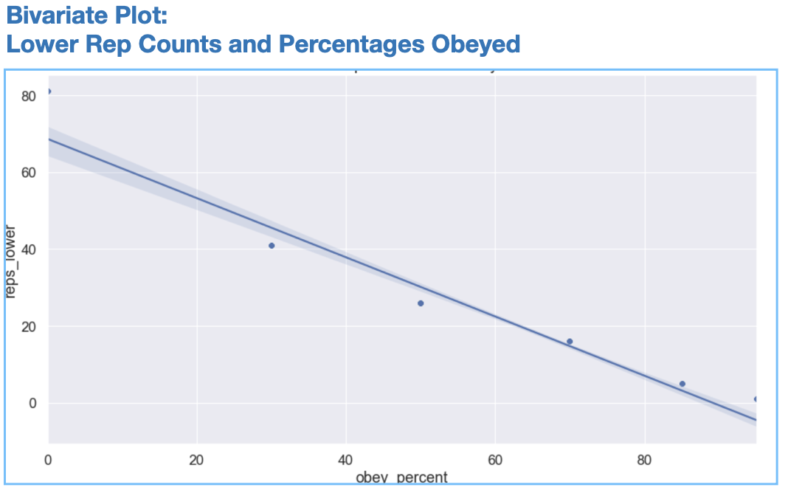
Analysis
Relationship between reps and obeyed percentages
Strong relationship between lower reps for new commands and high percentage for first commands
Shaded area shows more variance between reps and percent obeyed as rep number increases
Once number of reps is decreased and percent of first commands obeyed increases, relationship strengthens

Slide 8
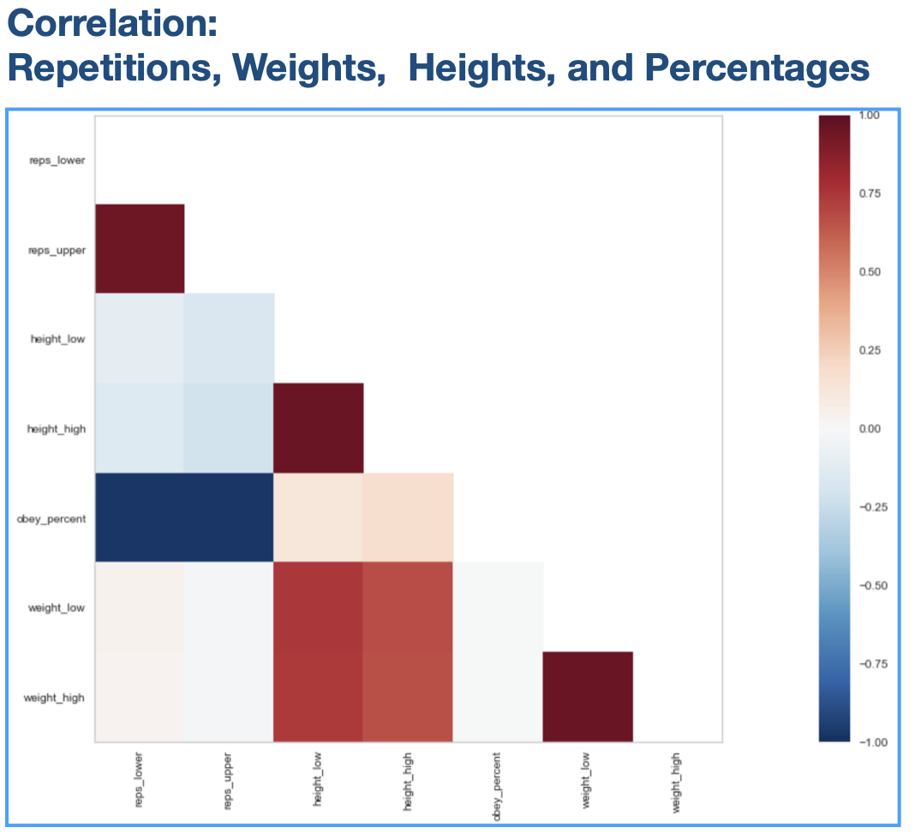
Analysis
Correlations
Relationships between lower repetitions and obeyed percentages
Also a small relationship between dog weights and repetitions
Not as strong

Slide 9
Limitations & Challenges
Small dataset
Difficult to split into meaningful test and training sets
Unreliable predictions
Incomplete data
Missing some breeds due to incomplete information

Slide 10
Conclusions, Future Use, & Recommendations
Correlation successfully matched similar breeds
Assists matching with prospective new owners
Used by rescues
Match new owners
Identify which dogs need more training
Results in better relationship between dogs and new owners

Slide 11
Thank You

